Slide 1



ML/DL for Everyone with
Lecture 13: RNN II
Sung Kim <hunkim+ml@gmail.com> HKUST
Code: https://github.com/hunkim/PyTorchZeroToAll
Slides: http://bit.ly/PyTorchZeroAll

Slide 2

Call for Comments
Please feel free to add comments directly on these slides.
Other slides: http://bit.ly/PyTorchZeroAll
Picture from http://www.tssablog.org/archives/3280

Slide 3
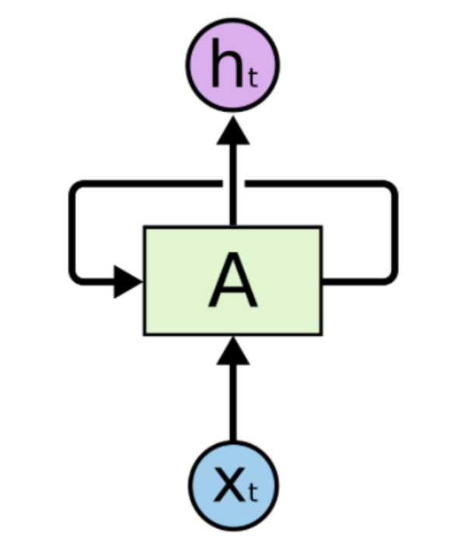
Typical RNN Models
Linear
P(y=0)
Embedding
(lookup table)
P(y=1)
…
P(y=n)
Loss
With CrossEntropy

Slide 4
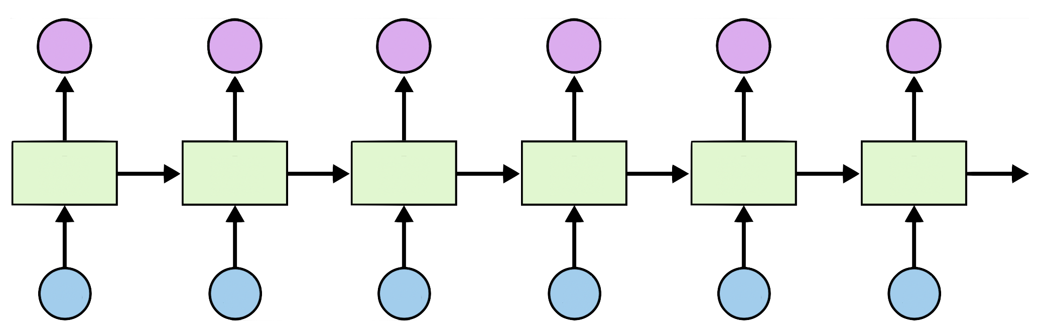
RNN Loss and training
l
l
l
l
l
l
[0.1, 0.6, 0.1, 0.1, 0.1]
h
i
h
e
l
l

Slide 5

RNN Applications
http://karpathy.github.io/2015/05/21/rnn-effectiveness/

Slide 6
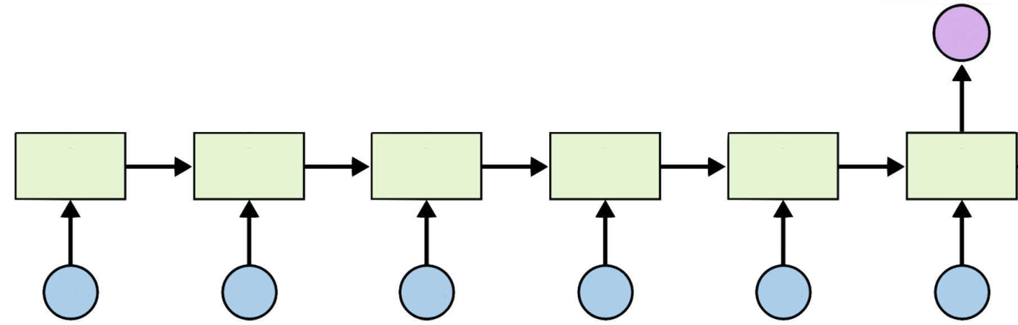
RNN Classification
http://karpathy.github.io/2015/05/21/rnn-effectiveness/

Slide 7
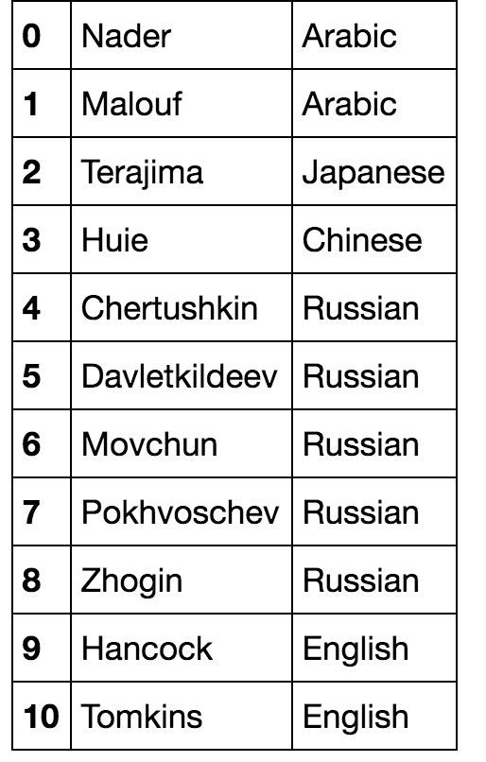
Name Classification
Softmax output
(18 countries)
[ z h o g i n ]

Slide 8
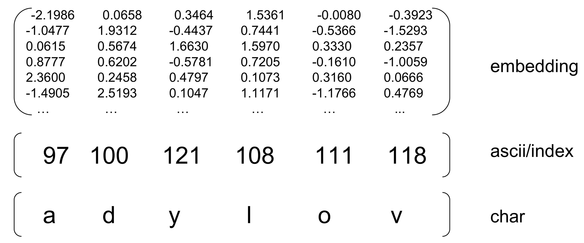
Input representations
Softmax output
(18 countries)
Matrix visualization from Nicolas, https://github.com/ngarneau

Slide 9
Implementation
class RNNClassifier(nn.Module):
def __init__(self, input_size, hidden_size, output_size, n_layers=1):
super(RNNClassifier, self).__init__()
self.hidden_size = hidden_size
self.n_layers = n_layers
self.embedding = nn.Embedding(input_size, hidden_size)
self.gru = nn.GRU(hidden_size, hidden_size, n_layers)
self.fc = nn.Linear(hidden_size, output_size)
def forward(self, input):
# Note: we run this all at once (over the whole input sequence)
# input = B x S . size(0) = B
batch_size = input.size(0)
# input: B x S -- (transpose) --> S x B
input = input.t()
# Embedding S x B -> S x B x I (embedding size)
print(" input", input.size())
embedded = self.embedding(input)
print(" embedding", embedded.size())
# Make a hidden
hidden = self._init_hidden(batch_size)
output, hidden = self.gru(embedded, hidden)
print(" gru hidden output", hidden.size())
# Use the last layer output as FC's input
# No need to unpack, since we are going to use hidden
fc_output = self.fc(hidden)
print(" fc output", fc_output.size())
return fc_output
def _init_hidden(self, batch_size):
hidden = torch.zeros(self.n_layers, batch_size, self.hidden_size)
return Variable(hidden)
if __name__ == '__main__':
classifier = RNNClassifier(N_CHARS,
HIDDEN_SIZE, N_CLASSES)
arr, _ = str2ascii_arr('adylov')
inp = Variable(torch.LongTensor([arr]))
out = classifier(inp)
print("in", inp.size(), "out", out.size())
# in torch.Size([1, 6])
#out torch.Size([1, 1, 18])

Slide 10
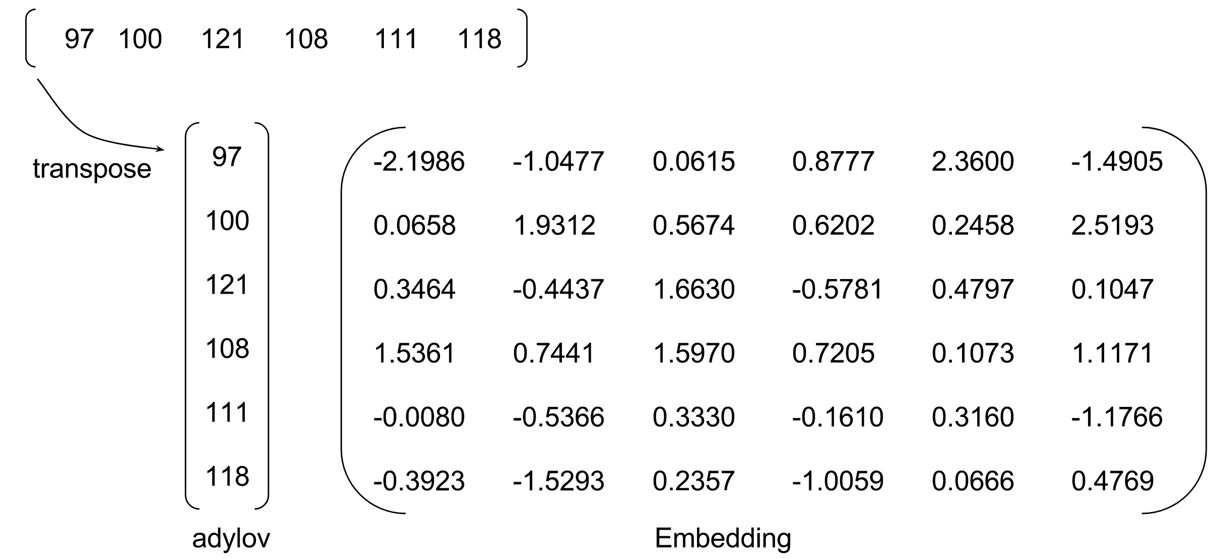
Implementation
class RNNClassifier(nn.Module):
def __init__(self, input_size, hidden_size, output_size, n_layers=1):
super(RNNClassifier, self).__init__()
self.hidden_size = hidden_size
self.n_layers = n_layers
self.embedding = nn.Embedding(input_size, hidden_size)
self.gru = nn.GRU(hidden_size, hidden_size, n_layers)
self.fc = nn.Linear(hidden_size, output_size)
def forward(self, input):
# Note: we run this all at once (over the whole input sequence)
# input = B x S . size(0) = B
batch_size = input.size(0)
# input: B x S -- (transpose) --> S x B
input = input.t()
# Embedding S x B -> S x B x I (embedding size)
print(" input", input.size())
embedded = self.embedding(input)
print(" embedding", embedded.size())
# Make a hidden
hidden = self._init_hidden(batch_size)
output, hidden = self.gru(embedded, hidden)
print(" gru hidden output", hidden.size())
# Use the last layer output as FC's input
# No need to unpack, since we are going to use hidden
fc_output = self.fc(hidden)
print(" fc output", fc_output.size())
return fc_output
def _init_hidden(self, batch_size):
hidden = torch.zeros(self.n_layers, batch_size, self.hidden_size)
return Variable(hidden)
if __name__ == '__main__':
classifier = RNNClassifier(N_CHARS,
HIDDEN_SIZE, N_CLASSES)
arr, _ = str2ascii_arr('adylov')
inp = Variable(torch.LongTensor([arr]))
out = classifier(inp)
print("in", inp.size(), "out", out.size())
# in torch.Size([1, 6])
#out torch.Size([1, 1, 18])

Slide 11
Batch?
if __name__ == '__main__':
names = ['adylov', 'solan', 'hard', 'san']
classifier = RNNClassifier(N_CHARS, HIDDEN_SIZE, N_CLASSES)
for name in names:
arr, _ = str2ascii_arr(name)
inp = Variable(torch.LongTensor([arr]))
out = classifier(inp)
print("in", inp.size(), "out", out.size())
# in torch.Size([1, 6]) out torch.Size([1, 1, 18])
# in torch.Size([1, 5]) out torch.Size([1, 1, 18]) # ...
if __name__ == '__main__':
classifier = RNNClassifier(N_CHARS,
HIDDEN_SIZE, N_CLASSES)
arr, _ = str2ascii_arr('adylov')
inp = Variable(torch.LongTensor([arr]))
out = classifier(inp)
print("in", inp.size(), "out", out.size())
# in torch.Size([1, 6])
#out torch.Size([1, 1, 18])

Slide 12
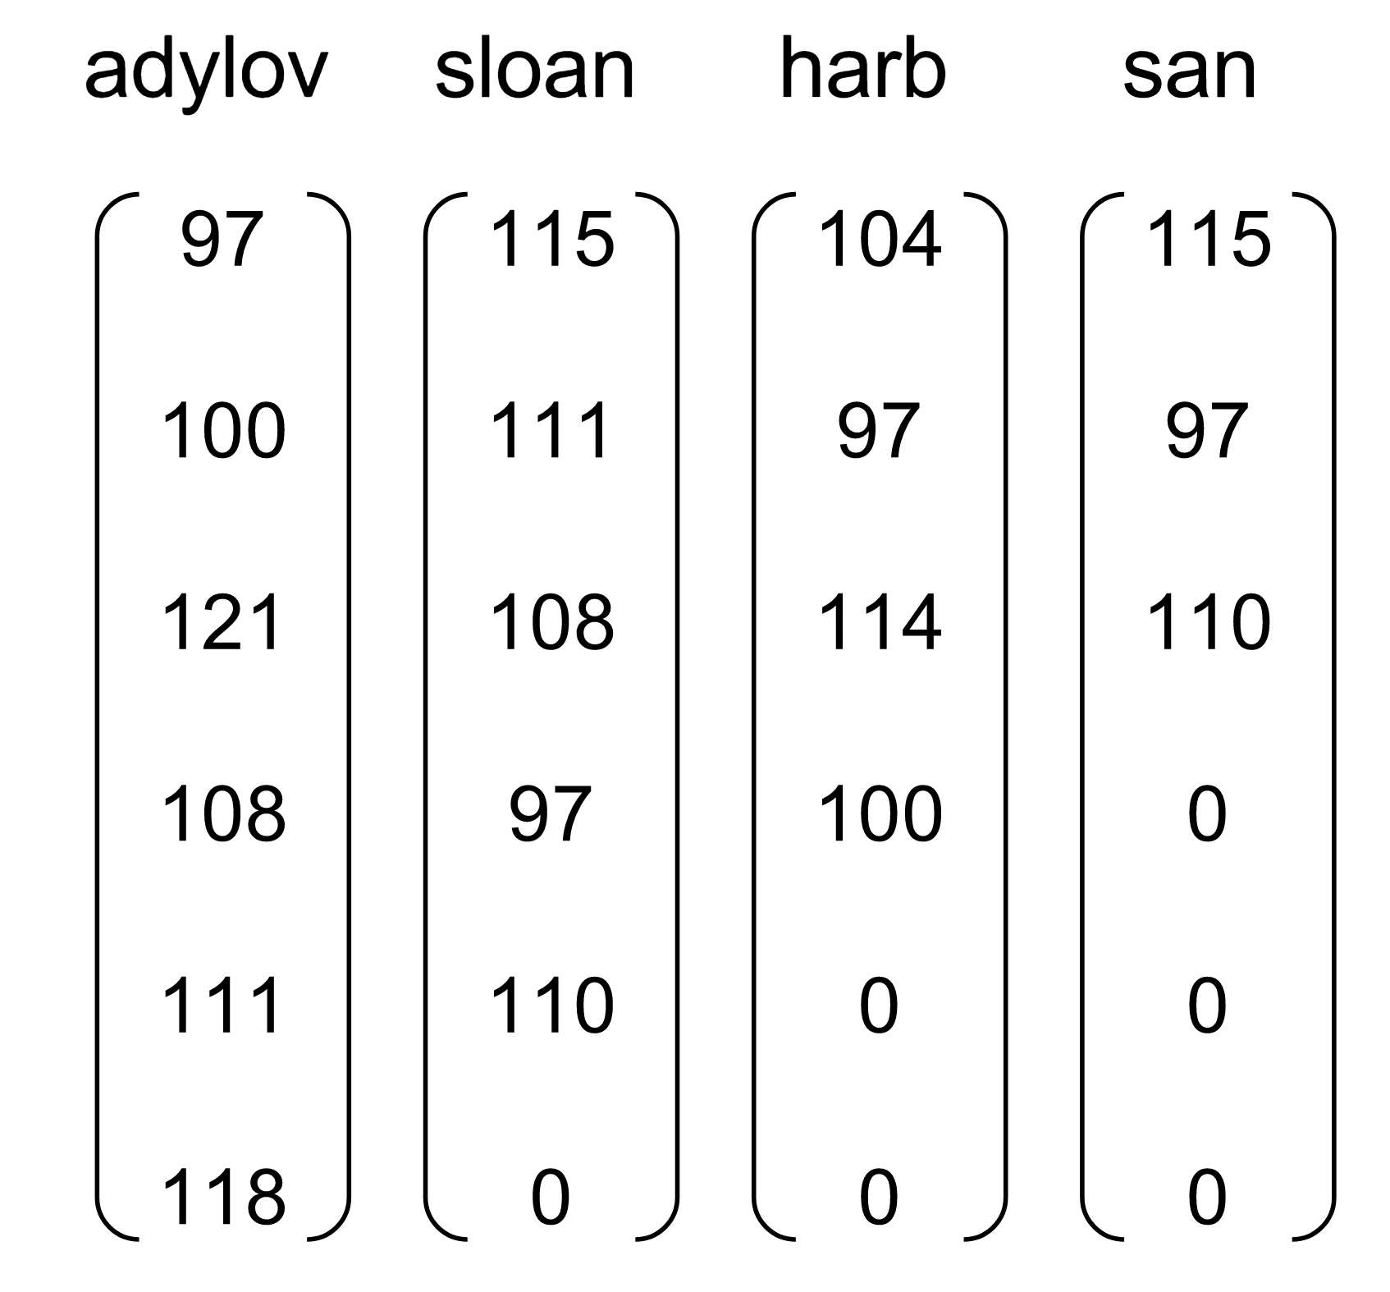
Batch?
if __name__ == '__main__':
names = ['adylov', 'solan', 'hard', 'san']
classifier = RNNClassifier(N_CHARS, HIDDEN_SIZE, N_CLASSES)
for name in names:
arr, _ = str2ascii_arr(name)
inp = Variable(torch.LongTensor([arr]))
out = classifier(inp)
print("in", inp.size(), "out", out.size())
# in torch.Size([1, 6]) out torch.Size([1, 1, 18])
# in torch.Size([1, 5]) out torch.Size([1, 1, 18]) # ...
if __name__ == '__main__':
classifier = RNNClassifier(N_CHARS,
HIDDEN_SIZE, N_CLASSES)
arr, _ = str2ascii_arr('adylov')
inp = Variable(torch.LongTensor([arr]))
out = classifier(inp)
print("in", inp.size(), "out", out.size())
# in torch.Size([1, 6])
#out torch.Size([1, 1, 18])

Slide 13
Zero padding

Slide 14
Zero padding

Slide 15
Zero padding
def pad_sequences(vectorized_seqs, seq_lengths):
seq_tensor = torch.zeros((len(vectorized_seqs), seq_lengths.max())).long()
for idx, (seq, seq_len) in enumerate(zip(vectorized_seqs, seq_lengths)):
seq_tensor[idx, :seq_len] = torch.LongTensor(seq)
return seq_tensor

Slide 16
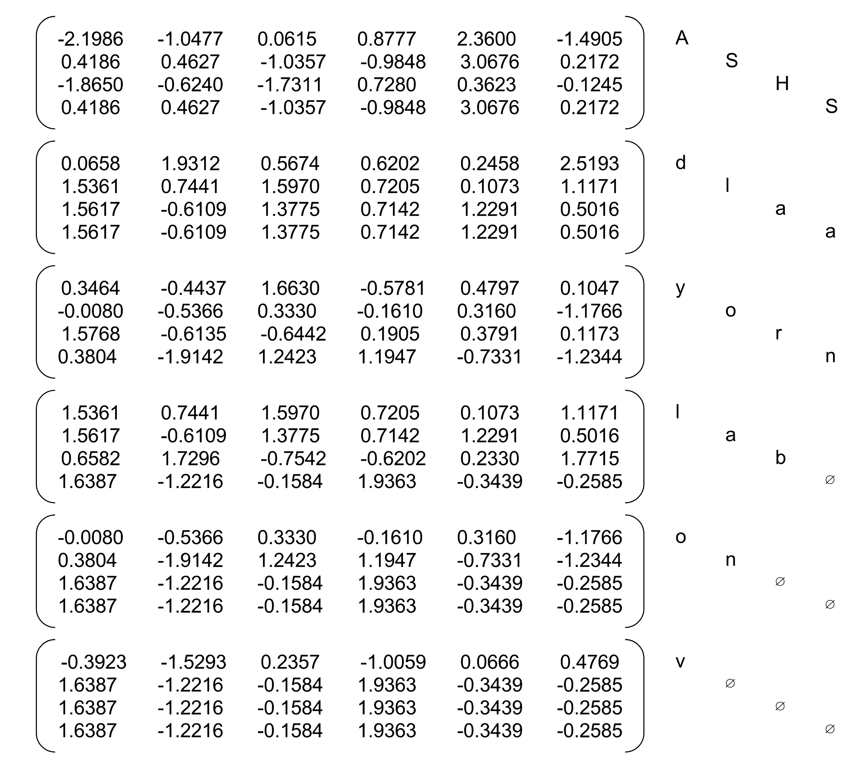
Embedding
# Embedding S x B -> S x B x I (embedding size)
embedded = self.embedding(input)

Slide 17
Full implementation
def str2ascii_arr(msg):
arr = [ord(c) for c in msg]
return arr, len(arr)
# pad sequences and sort the tensor
def pad_sequences(vectorized_seqs, seq_lengths):
seq_tensor = torch.zeros((len(vectorized_seqs), seq_lengths.max())).long()
for idx, (seq, seq_len) in enumerate(zip(vectorized_seqs, seq_lengths)):
seq_tensor[idx, :seq_len] = torch.LongTensor(seq)
return seq_tensor
# Create necessary variables, lengths, and target
def make_variables(names):
sequence_and_length = [str2ascii_arr(name) for name in names]
vectorized_seqs = [sl[0] for sl in sequence_and_length]
seq_lengths = torch.LongTensor([sl[1] for sl in sequence_and_length])
return pad_sequences(vectorized_seqs, seq_lengths)
if __name__ == '__main__':
names = ['adylov', 'solan', 'hard', 'san']
classifier = RNNClassifier(N_CHARS, HIDDEN_SIZE, N_CLASSES)
inputs = make_variables(names)
out = classifier(inp)
print("batch in", inp.size(), "batch out", out.size())
# batch in torch.Size([4, 6]) batch out torch.Size([1, 4, 18])

Slide 18
Full implementation
def str2ascii_arr(msg):
arr = [ord(c) for c in msg]
return arr, len(arr)
# pad sequences and sort the tensor
def pad_sequences(vectorized_seqs, seq_lengths):
seq_tensor = torch.zeros((len(vectorized_seqs), seq_lengths.max())).long()
for idx, (seq, seq_len) in enumerate(zip(vectorized_seqs, seq_lengths)):
seq_tensor[idx, :seq_len] = torch.LongTensor(seq)
return seq_tensor
# Create necessary variables, lengths, and target
def make_variables(names):
sequence_and_length = [str2ascii_arr(name) for name in names]
vectorized_seqs = [sl[0] for sl in sequence_and_length]
seq_lengths = torch.LongTensor([sl[1] for sl in sequence_and_length])
return pad_sequences(vectorized_seqs, seq_lengths)
if __name__ == '__main__':
names = ['adylov', 'solan', 'hard', 'san']
classifier = RNNClassifier(N_CHARS, HIDDEN_SIZE, N_CLASSES)
inputs = make_variables(names)
out = classifier(inputs)
print("batch in", inputs.size(), "batch out", out.size())
# batch in torch.Size([4, 6]) batch out torch.Size([1, 4, 18])
optimizer = torch.optim.Adam(classifier.parameters(),
lr=0.001)
criterion = nn.CrossEntropyLoss()
…
loss = criterion(output, target)
classifier.zero_grad()
loss.backward()
optimizer.step()

Slide 19
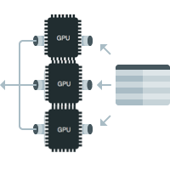


GPU/Data Parallel
Copy all variables to gpu
if torch.cuda.is_available():
return Variable(tensor.cuda())
else:
return Variable(tensor)
Put your models on gpu
classifier = RNNClassifier(N_CHARS, HIDDEN_SIZE, ...
if torch.cuda.is_available():
classifier.cuda()

Slide 20

GPU/Data Parallel
Copy all variables to gpu
if torch.cuda.is_available():
return Variable(tensor.cuda())
else:
return Variable(tensor)
Put your models on gpu
classifier = RNNClassifier(N_CHARS, HIDDEN_SIZE, ...
if torch.cuda.is_available():
classifier.cuda()
Wrap your model using data parallel
if torch.cuda.device_count() > 1:
print("Let's use", torch.cuda.device_count(), "GPUs!")
# dim = 0 [33, xxx] -> [11, ...], [11, ...], [11, ...] on 3 GPUs
classifier = nn.DataParallel(classifier)

Slide 21
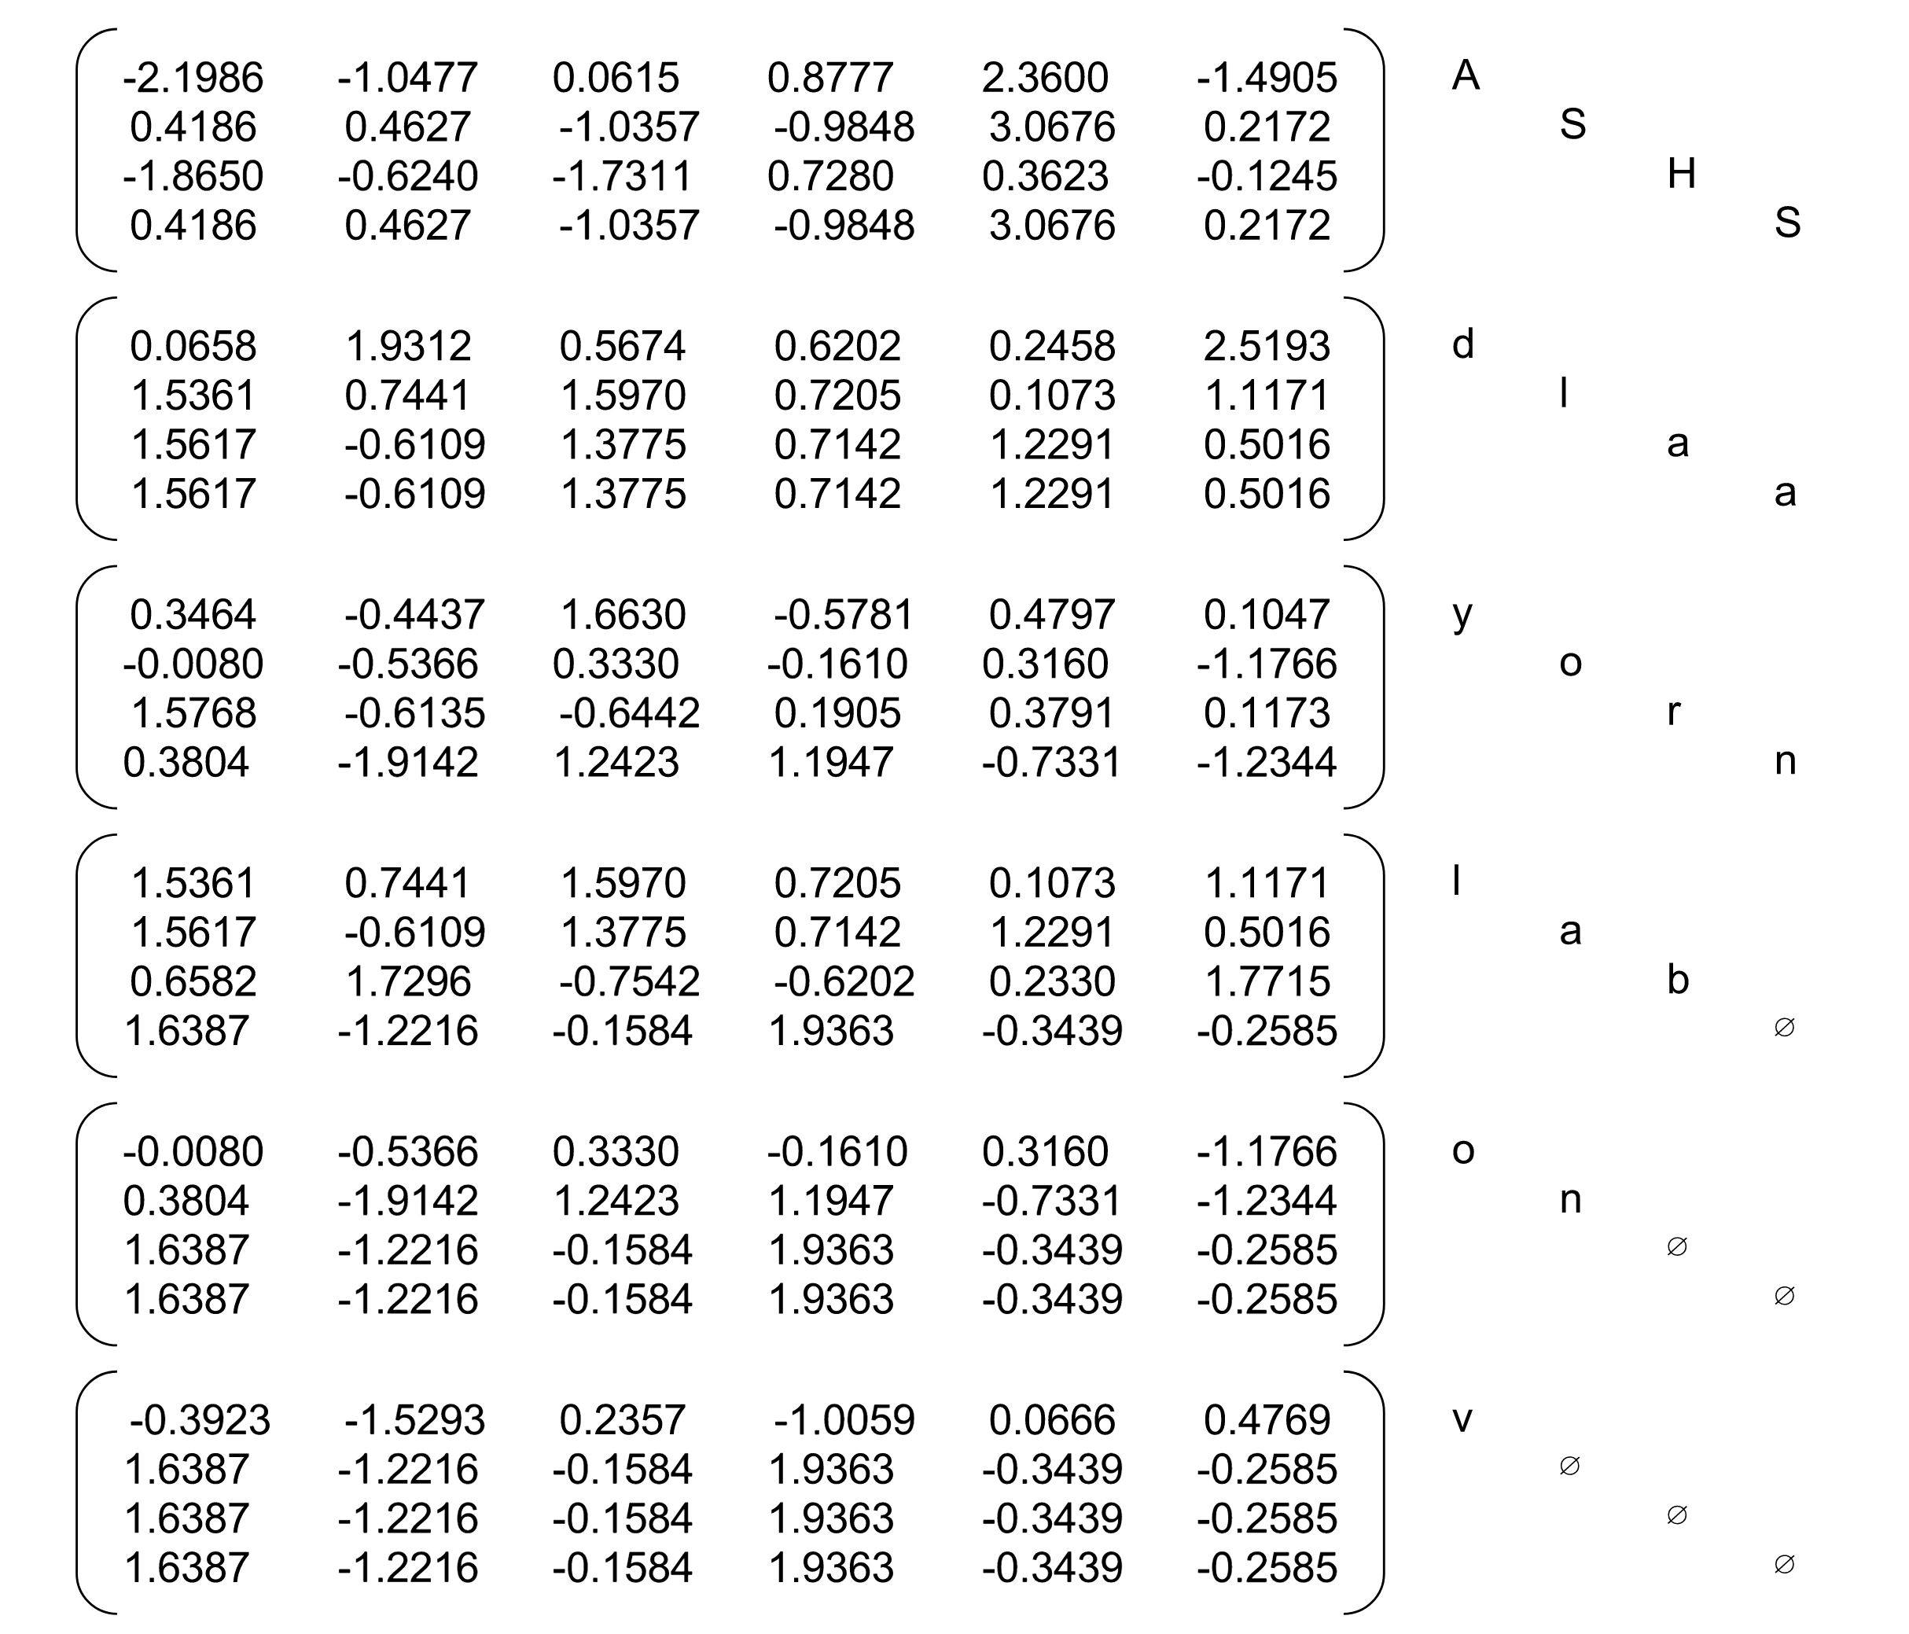
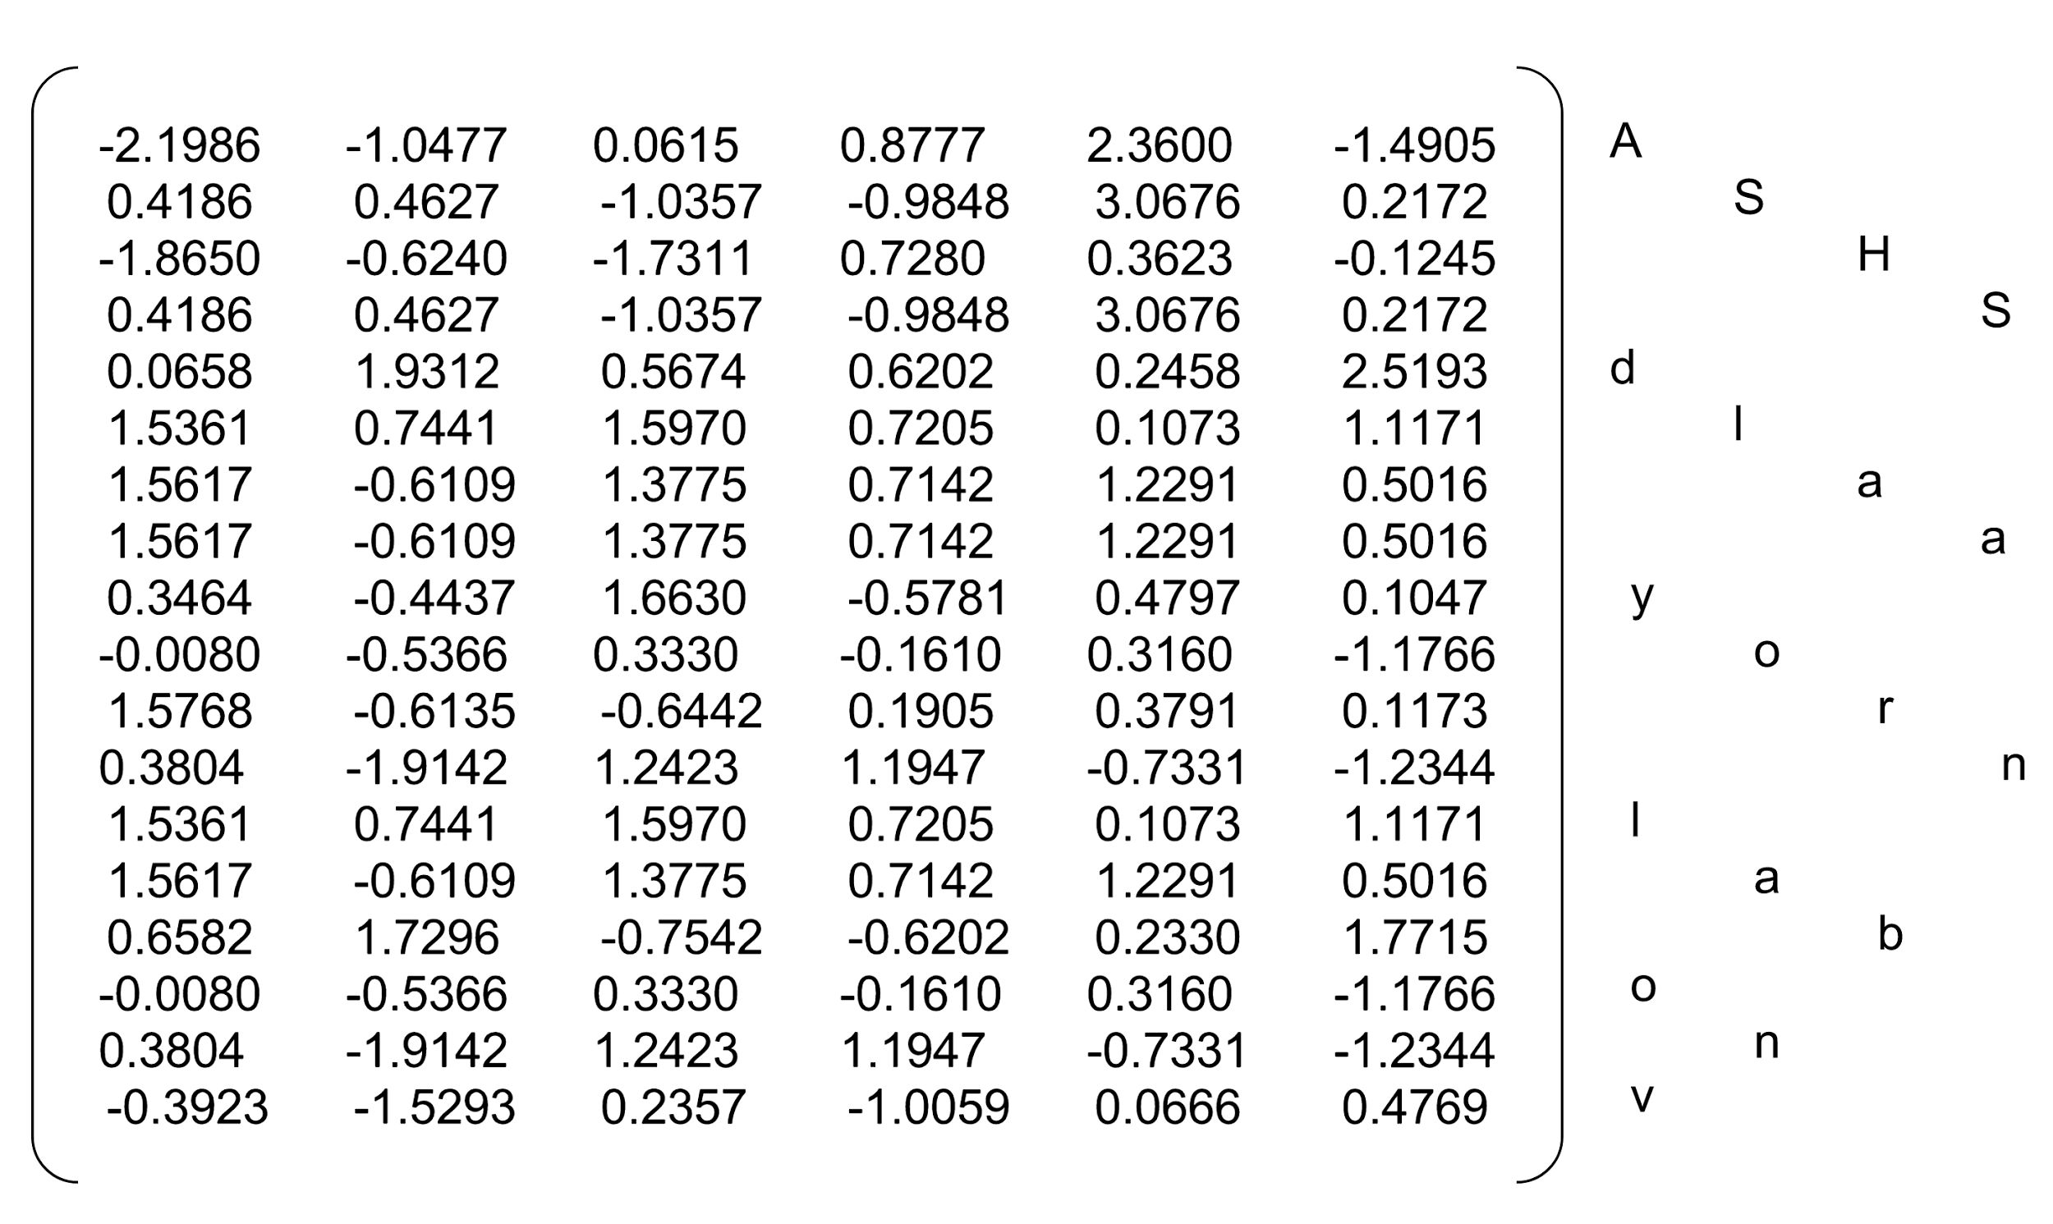
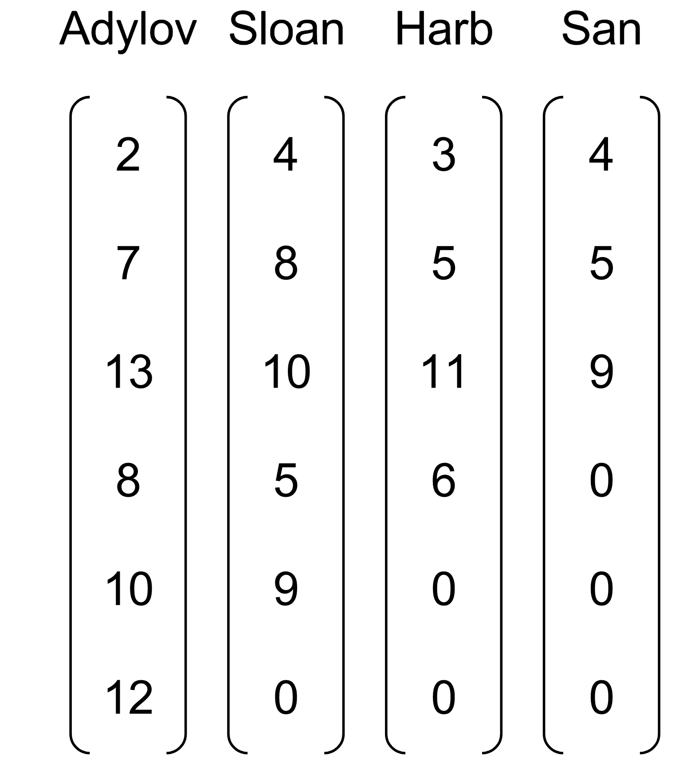
Efficiently handling batched sequences with variable lengths:
pack_padded_sequence
embedding
packing
RNN
Ordered batch
(by length)
Matrix visualization from Nicolas, https://github.com/ngarneau

Slide 22
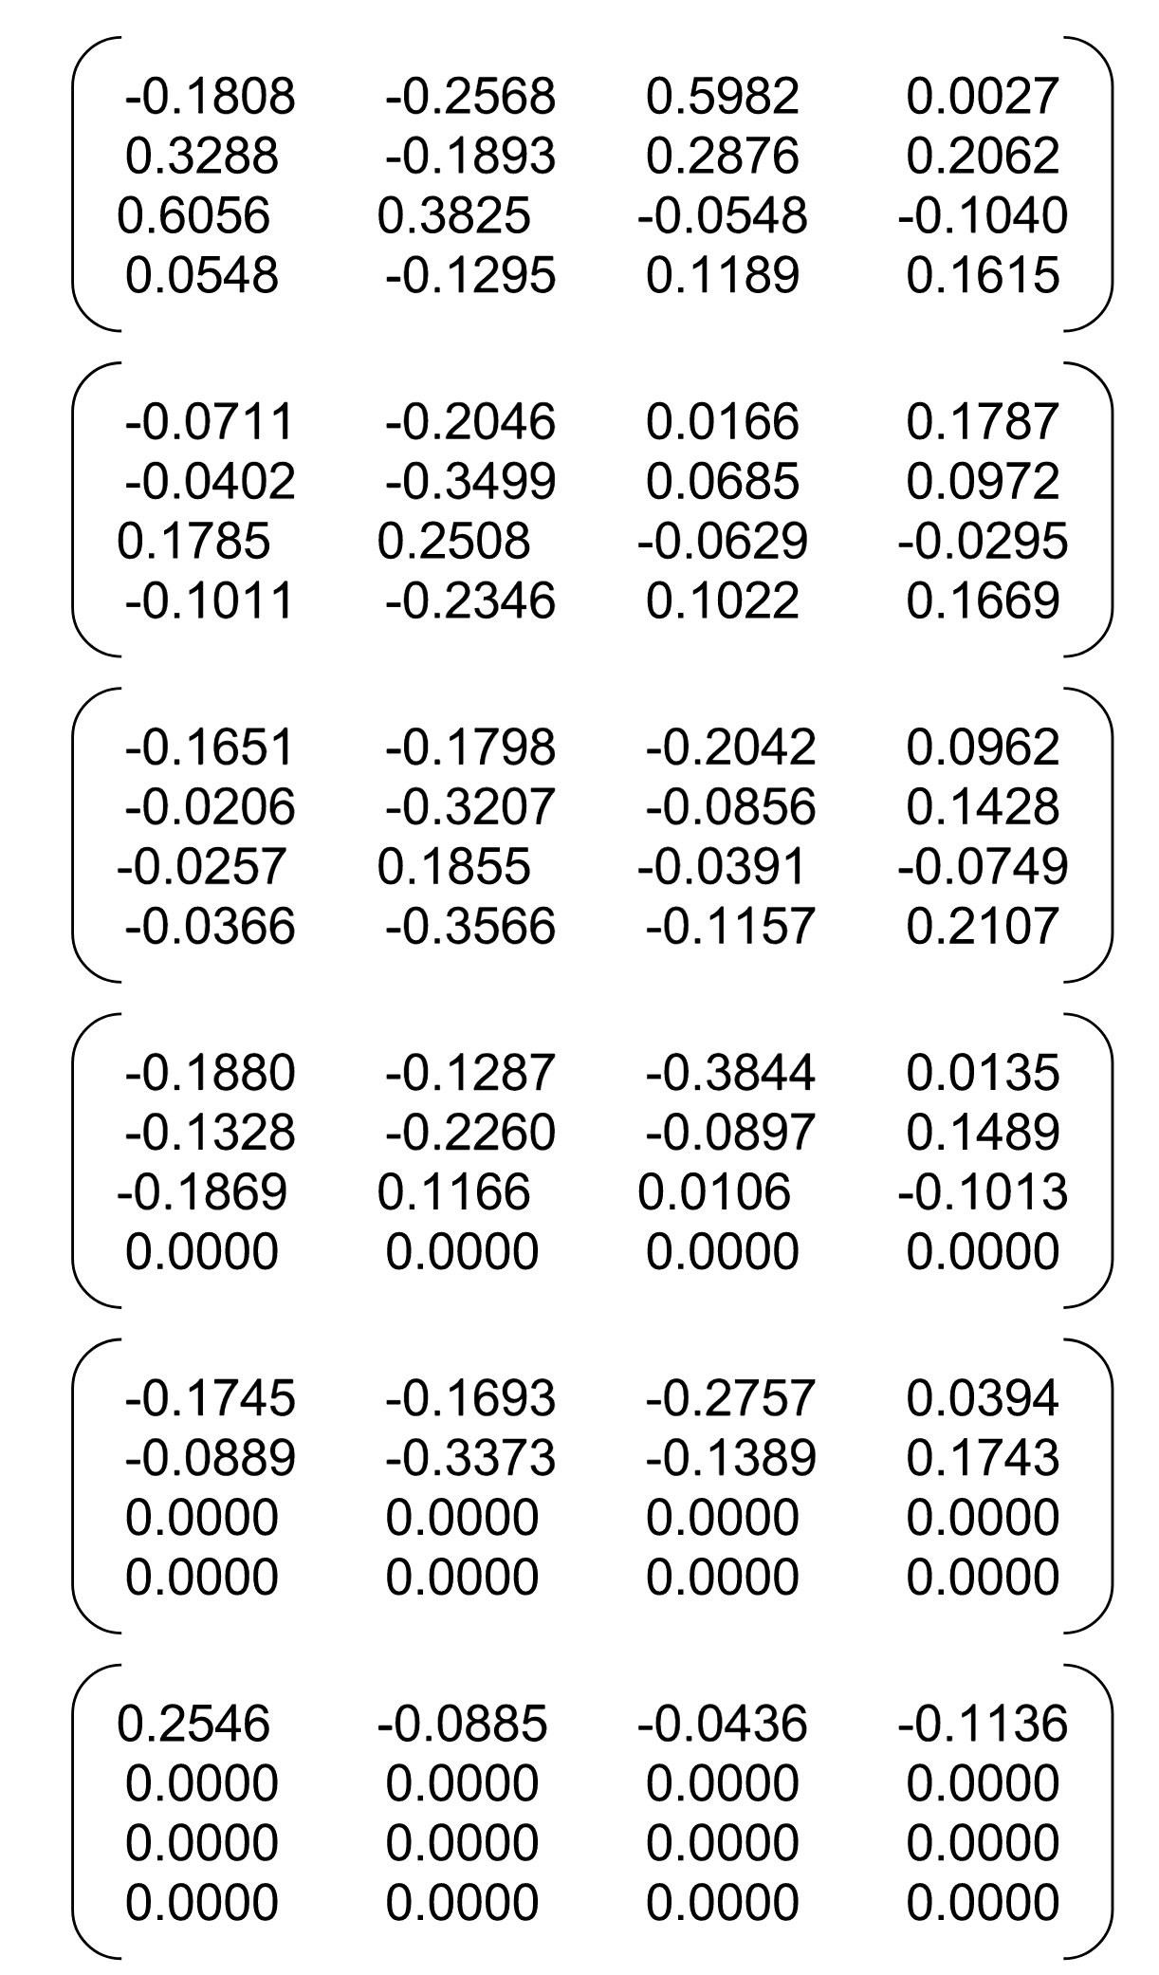
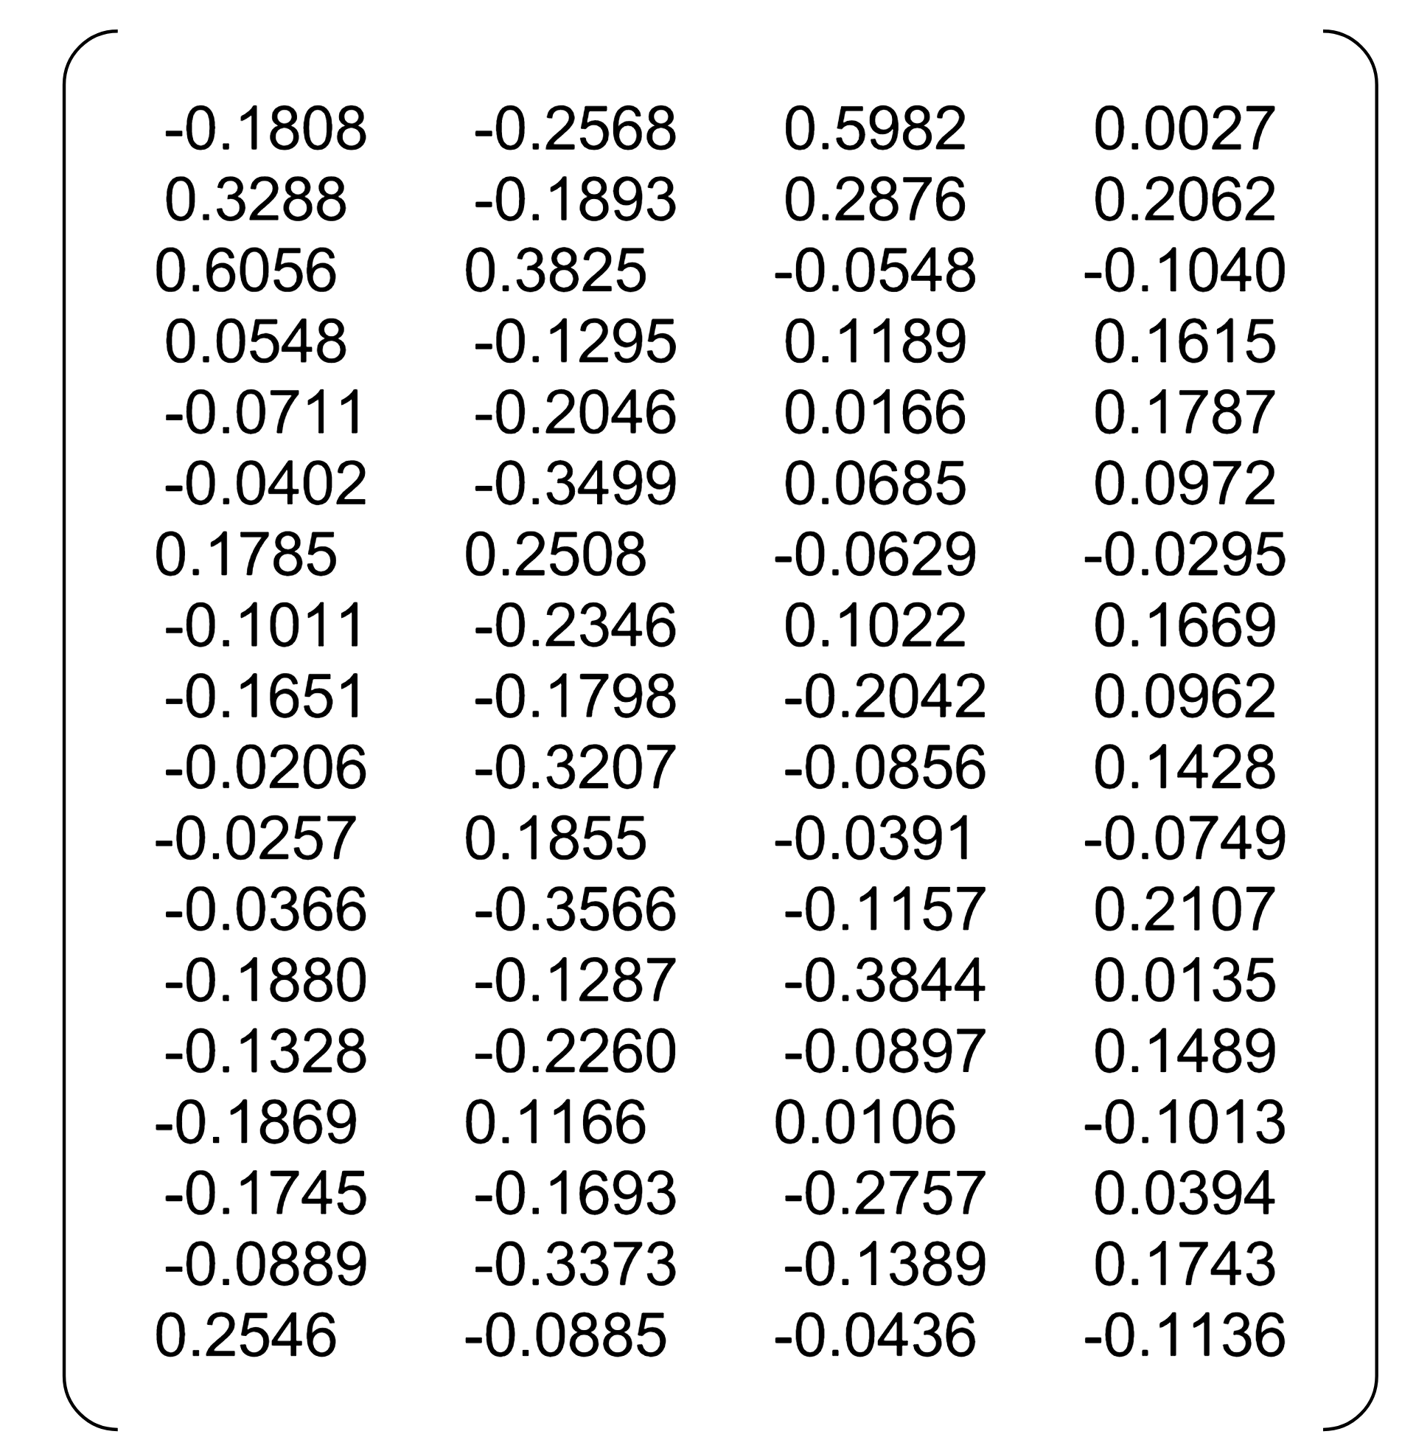
Efficiently handling batched sequences with variable lengths:
pack_padded_sequence
RNN
Out
unpack
Matrix visualization from Nicolas, https://github.com/ngarneau

Slide 23
Efficiently handling batched sequences with variable lengths:
pack_padded_sequence
(a) With packing and unpacking
Matrix visualization from Nicolas, https://github.com/ngarneau

Slide 24
Efficiently handling batched sequences with variable lengths:
pack_padded_sequence
(a) With packing and unpacking
(b) Without packing and unpacking
Matrix visualization from Nicolas, https://github.com/ngarneau

Slide 25
Exercise 13-1: Implement the full name classification
With GPU
With data parallel
Use pad-pack

Slide 26
(Character level) Language Modeling
h
hi

Slide 27
(Character level) Language Modeling
hi
hi!

Slide 28
(Character level) Language Modeling
hi! This is sun
hi! This is sung

Slide 29
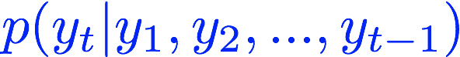
(Character level) Language Modeling
hi! This is sun
hi! This is sung

Slide 30
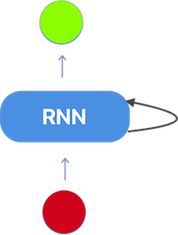
Language Modeling using RNN
def generate(decoder, prime_str='A', predict_len=100, temperature=0.8):
hidden = decoder.init_hidden()
prime_input = str2tensor(prime_str)
predicted = prime_str
# Use priming string to "build up" hidden state
for p in range(len(prime_str) - 1):
_, hidden = decoder(prime_input[p], hidden)
inp = prime_input[-1]
for p in range(predict_len):
output, hidden = decoder(inp, hidden)
# Sample from the network as a multinomial distribution
output_dist = output.data.view(-1).div(temperature).exp()
top_i = torch.multinomial(output_dist, 1)[0]
# Add predicted character to string and use as next input
predicted_char = chr(top_i)
predicted += predicted_char
inp = str2tensor(predicted_char)
return predicted
i! This is sung
hi! This is sun

Slide 31
Training
def train_teacher_forching(line):
input = str2tensor(line[:-1])
target = str2tensor(line[1:])
hidden = RNNdecoder.init_hidden()
loss = 0
for c in range(len(input)):
output, hidden = decoder(input[c], hidden)
loss += criterion(output, target[c])
decoder.zero_grad()
loss.backward()
decoder_optimizer.step()
return loss.data[0] / len(input)
i! This is sung
hi! This is sun

Slide 32
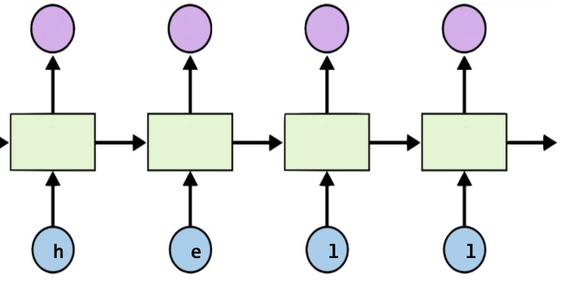
Teacher Forcing
def train_teacher_forching(line):
input = str2tensor(line[:-1])
target = str2tensor(line[1:])
hidden = RNNdecoder.init_hidden()
loss = 0
for c in range(len(input)):
output, hidden = decoder(input[c], hidden)
loss += criterion(output, target[c])
decoder.zero_grad()
loss.backward()
decoder_optimizer.step()
return loss.data[0] / len(input)
Teacher Forcing
https://www.quora.com/What-is-the-teacher-forcing-in-RNN

Slide 33
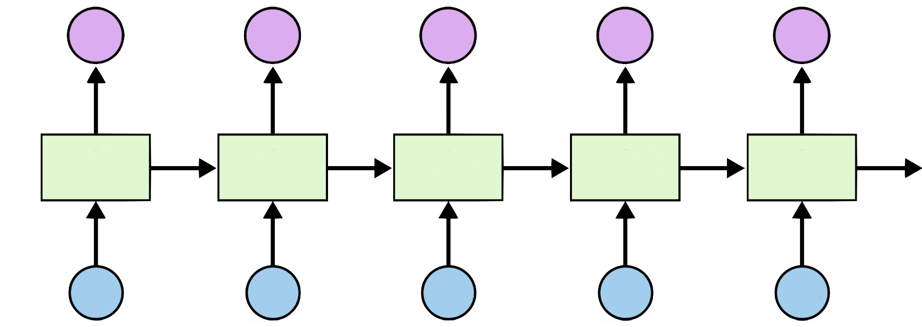
Teacher Forcing
y₁
y_{t}
h_{t}
x₁ = 0
x₂ = y₁
y_{t-1}
Teacher Forcing
No Teacher Forcing (more natural)
https://www.quora.com/What-is-the-teacher-forcing-in-RNN

Slide 34
Training: no teacher forcing
def train(line):
input = str2tensor(line[:-1])
target = str2tensor(line[1:])
hidden = decoder.init_hidden()
decoder_in = input[0]
loss = 0
for c in range(len(input)):
output, hidden = decoder(decoder_in, hidden)
loss += criterion(output, target[c])
decoder_in = output.max(1)[1]
decoder.zero_grad()
loss.backward()
decoder_optimizer.step()
return loss.data[0] / len(input)
y₁
y_{t}
h_{t}
x₁ = 0
x₂ = y₁
y_{t-1}

Slide 35

Exercise 13-2: Language model with Obama speech
http://obamaspeeches.com/

Slide 36


Lecture 14:
Sequence to Sequence

